Slide 1

9/09/2024
Convolutional
Neural Networks
High Performance Machine Learning Group

Slide 2
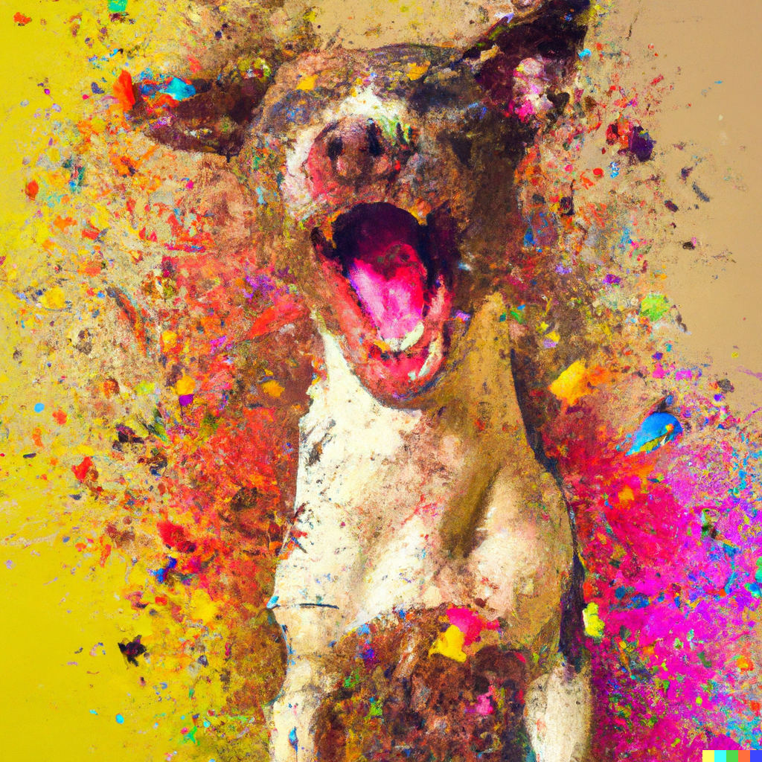


Image Representation
Is a matrix or grid of intensity values
integers [0, 255] or float points [0,1]
Each element in the matrix is a pixel
Can have 1 greyscale channel or multiple colour channels: RGB

Slide 3
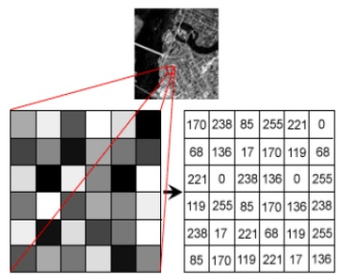
Image Representation
Is a matrix or grid of intensity values
integers [0, 255] or float points [0,1]
Each element in the matrix is a pixel
Can have 1 greyscale channel or multiple colour channels: RGB

Slide 4
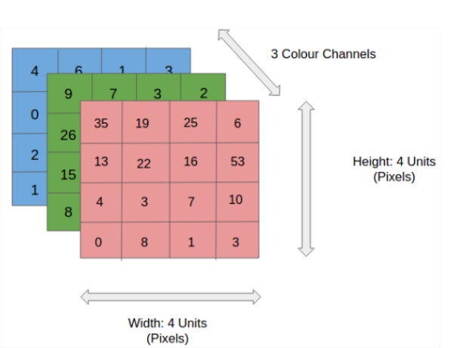
Image Representation
Is a matrix or grid of intensity values
integers [0, 255] or float points [0,1]
Each element in the matrix is a pixel
Can have 1 greyscale channel or multiple colour channels: RGB

Slide 5
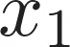

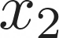
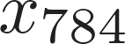
Correlated structures
...
...
...
...
Notes:
We could apply MLPs from previous slides to images by flattening the array, however...

Slide 6
Correlated structures
...
...
...
...
Images are correlated spatially
Strong correlation between neighbouring pixels
Shifting an object will not alter its essence

Slide 7
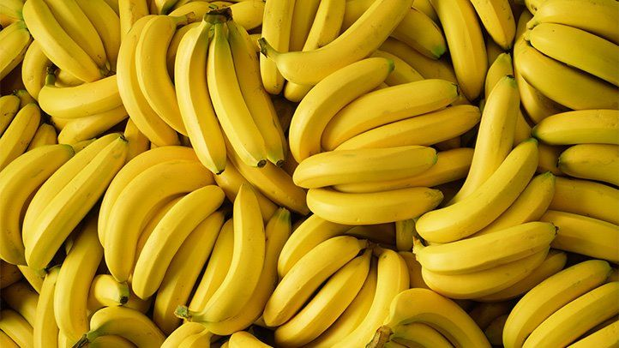
Correlated structures
...
...
...
...
Images are correlated spatially
Strong correlation between neighbouring pixels
Shifting an object will not alter its essence

Slide 8
Correlated structures
...
...
...
...
Images are correlated spatially
Strong correlation between neighbouring pixels
Shifting an object will not alter its essence

Slide 9
Correlated structures
...
...
...
...
Images are correlated spatially
Strong correlation between neighbouring pixels
Shifting an object will not alter its essence

Slide 10
Correlated structures
...
...
...
...
Images are correlated spatially
Strong correlation between neighbouring pixels
Shifting an object will not alter its essence

Slide 11
Correlated structures
...
...
...
...
Images are correlated spatially
Strong correlation between neighbouring pixels
Shifting an object will not alter its essence
We want to detect the features across an image and aggregate them
Form complete features higher up in the hierarchy (in later layers)

Slide 12
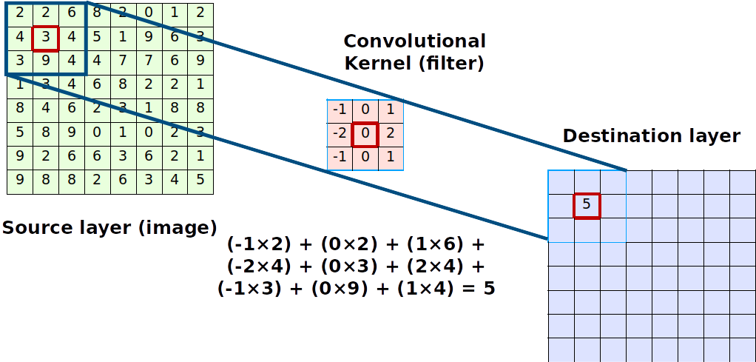

Convolutions Compute
Notes:
We do this with convolutions.
Given a source image, and a convolution kernel...

Slide 13
Convolutions Compute
The kernel is shifted across the image and produces a point value
The step size in which it shifts is the stride
The output is always smaller. We can use padding to preserve dimensions

Slide 14
Convolutions Compute
The kernel is shifted across the image and produces a point value
The step size in which it shifts is the stride
The output is always smaller. We can use padding to preserve dimensions
The image shrinks according to
Output_size = inputSize -(KernelSize - 1)

Slide 15
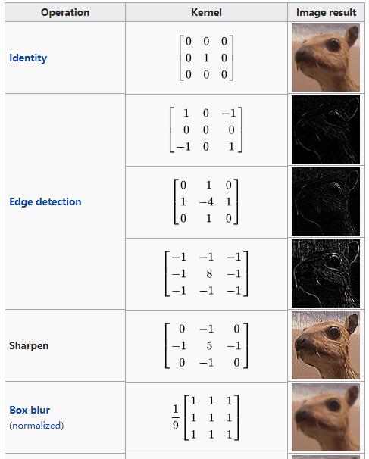
Convolutions
Kernel (filter): small matrix that we use to convolve an image
Convolution:
An operation that “blends” one function with another.
A filter applies a convolution operation on an image
Notes:
Examples of filters

Slide 16
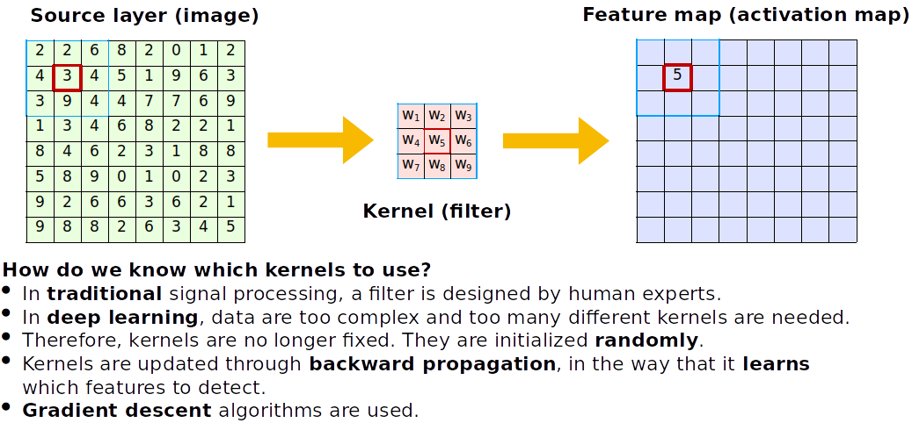
Convolutions
How do we know which kernels to use?
Kernels are initialized randomly and learnt during training, allowing the CNN to learn spatial features

Slide 17
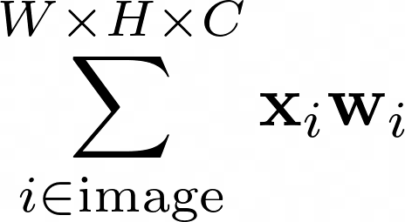
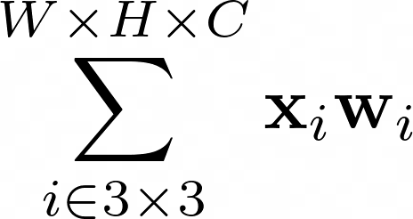
Convolutions
Fully connected
Locally connected
shared weights
How do we know which kernels to use?
Kernels are initialized randomly and learnt during training, allowing the CNN to learn spatial features
Notes:
Where before the entire input contributes to all outputs, here only the input that lies in the kernel "shadow" contributes to the output

Slide 18
Convolutions
Fully connected
Locally connected
shared weights
How do we know which kernels to use?
Kernels are initialized randomly and learnt during training, allowing the CNN to learn spatial features
Notes:
We can then add multiple output channels to increase complexity

Slide 19
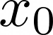
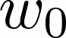
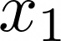
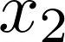
Anatomy of an Convolutional Neural Network
CNNs actually look a lot like normal Dense Neural Networks
Interpretation: Every node is a kernel

Slide 20
Anatomy of an Convolutional Neural Network
See the nodes as moving across the image!
We say these are shared weights
CNNs actually look a lot like normal Dense Neural Networks
Interpretation: Every node is a kernel

Slide 21

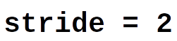
Pooling
We could discard information gradually by max pooling
Keep the strongest signal, works better than average pooling
Nowadays, we use a bigger convolution stridefor dimensionality reduction
Notes:
We can use pooling to reduce the image size

Slide 22
CNN Cases
High Performance Machine Learning Group
Notes:
Let's discuss some cases where CNNs are applied

Slide 23
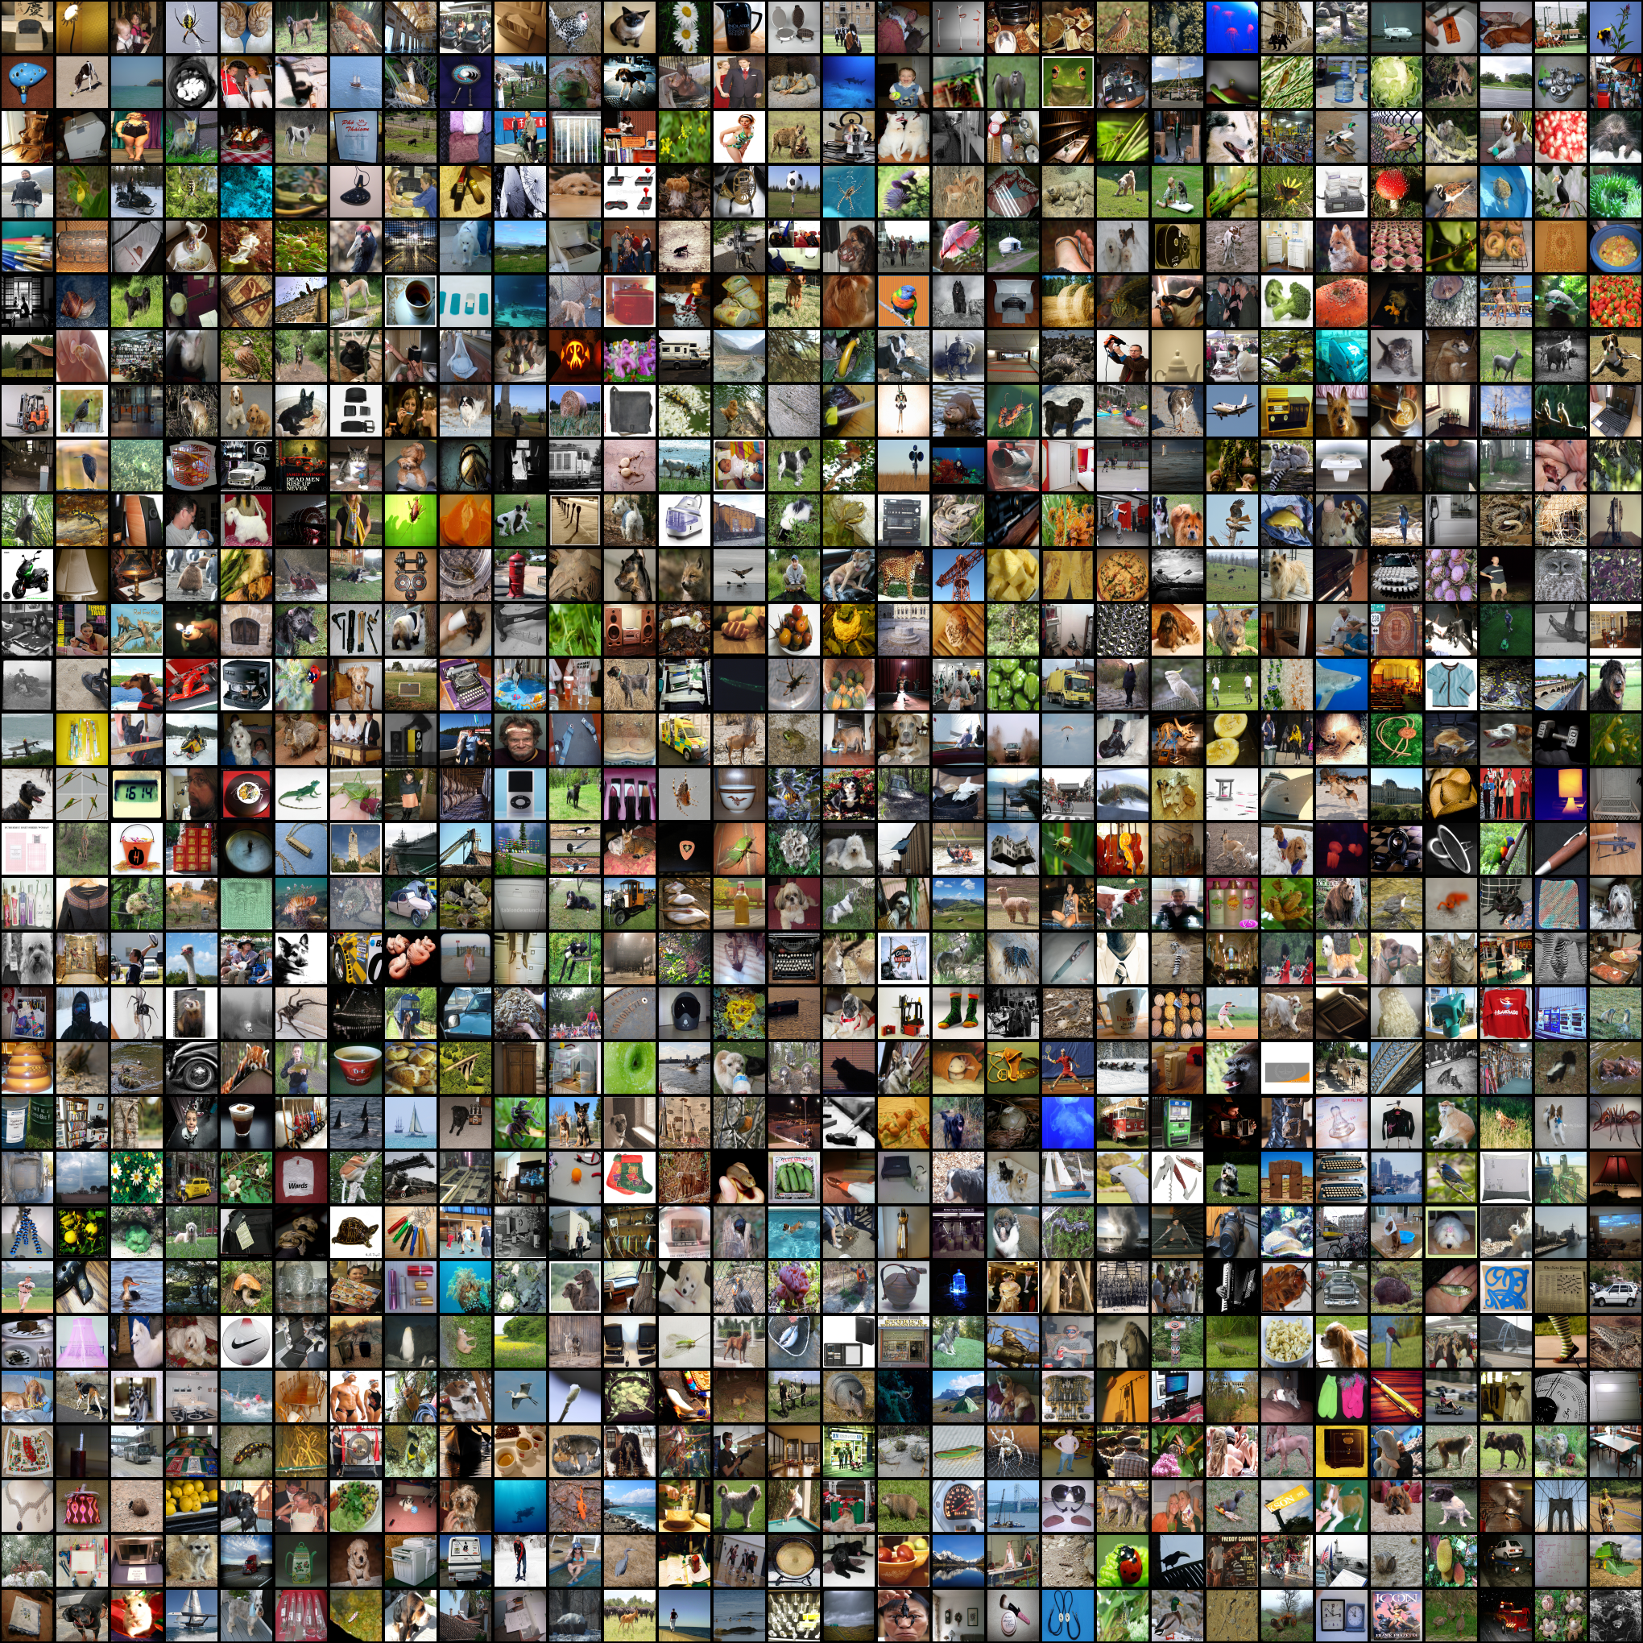

ImageNet Challenge
Computer Vision Benchmark 1.4M Images, 1000 classes
Image Classification Difficult until 2012

Slide 24
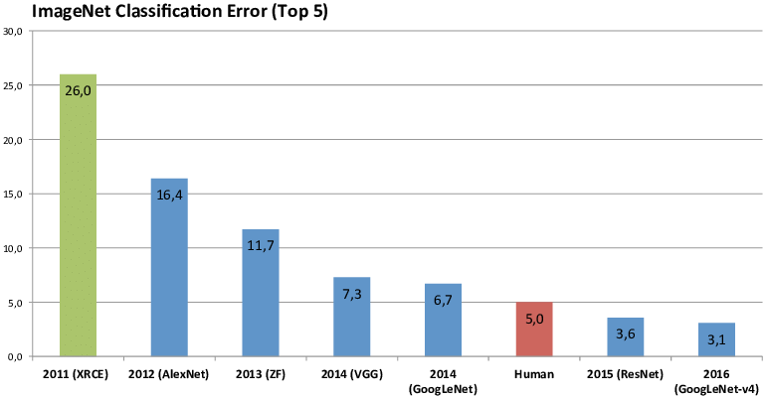
ImageNet Challenge
Computer Vision Benchmark 1.4M Images, 1000 classes
Image Classification Difficult until 2012
Notes:
In 2012 a big step was made by AlexNet, with ResNet first surpassing humans in 2015

Slide 25
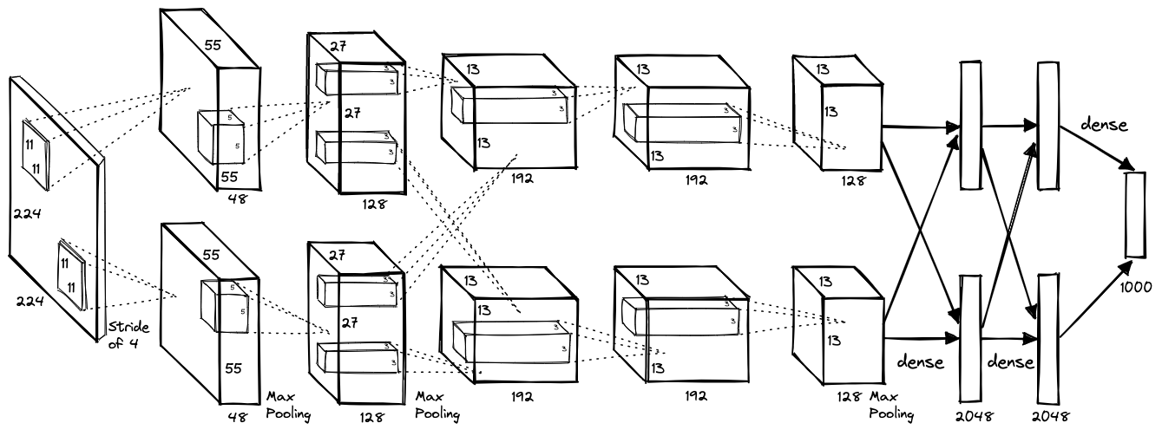
AlexNet (2012)
Notes:
Let's take a look at alexnet. Explain graph

Slide 26
AlexNet (2012)
Images become smaller and number of filters increases as we go deeper
8 layers with dropout and ReLU activations trained for 6 days on 2 GPUs

Slide 27
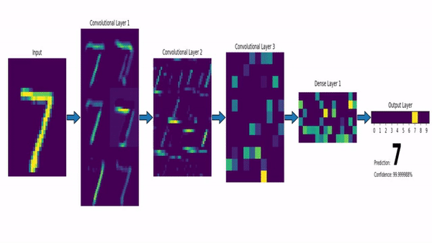
CNN with a Dense Layer output
https://www.louisbouchard.ai/densenet-explained/
Notes:
Example of intermediate features

Slide 28
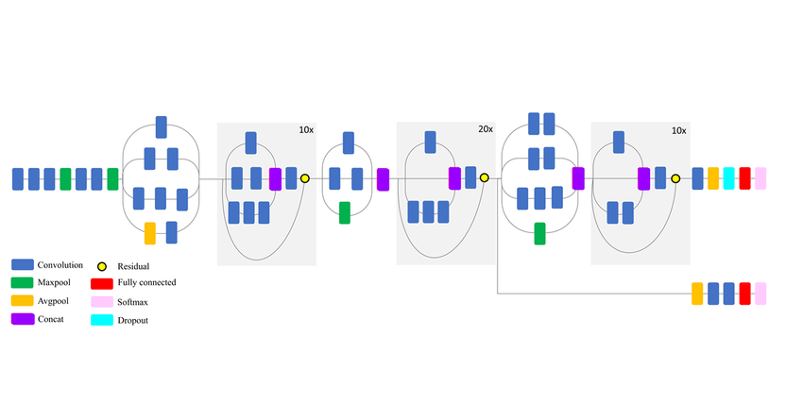
Transfer Learning

Slide 29
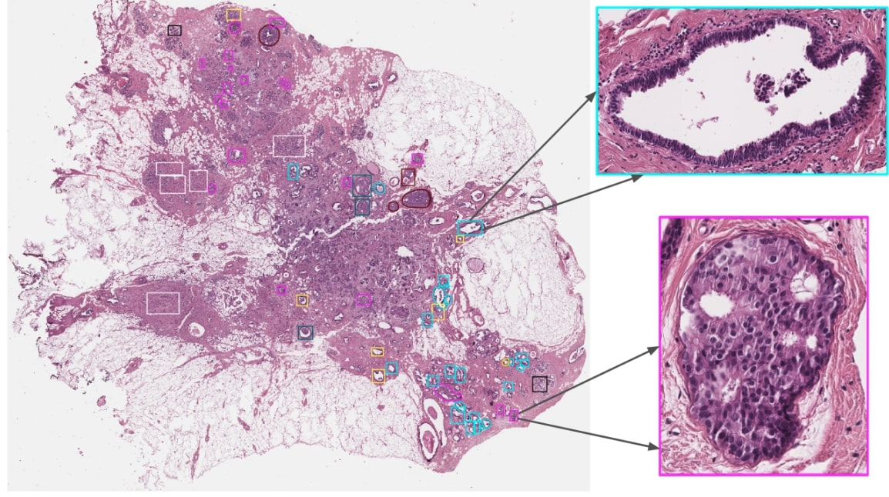
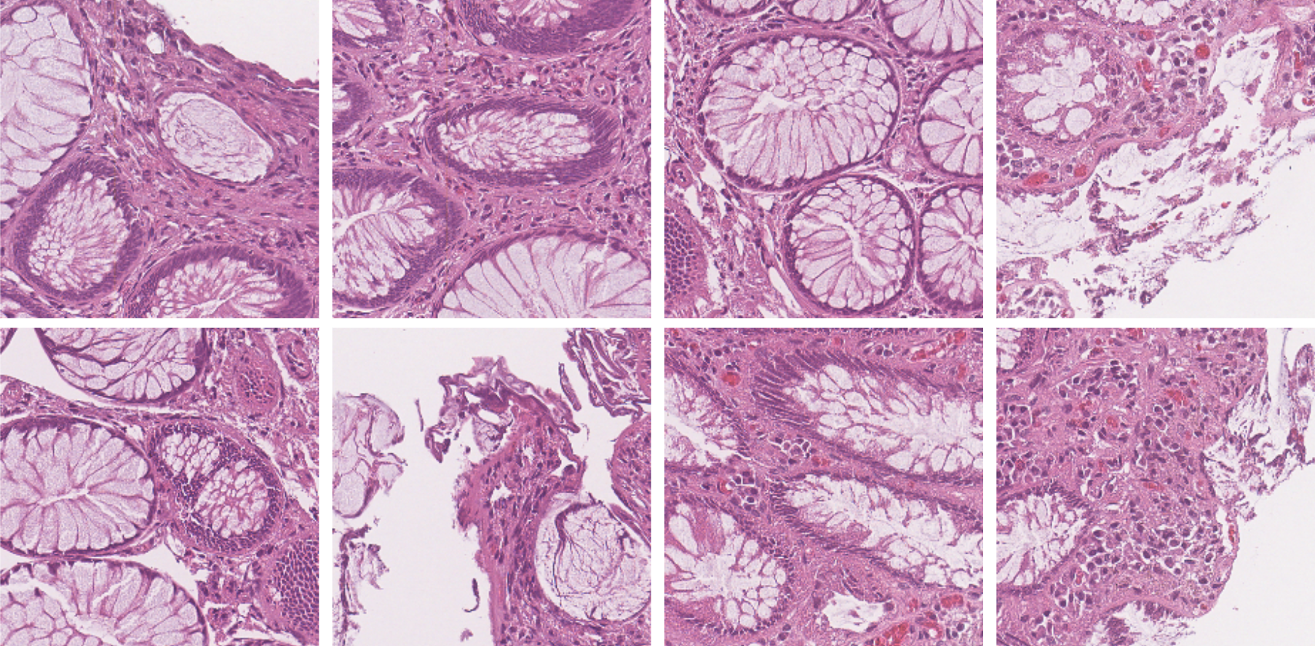
Transfer Learning

Slide 30

VGG16 and ResNet (2014, 2015)
VGG16: construct large and deep models (120M params)
Prevents vanishing gradient problem

Slide 31
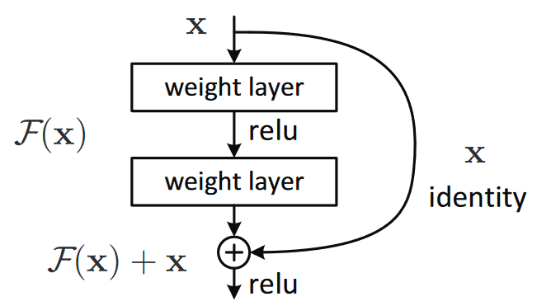
VGG16 and ResNet (2014, 2015)
VGG16: construct large and deep models (120M params)
Prevents vanishing gradient problem

Slide 32
ResNet (2015)
Notes:
Resnet introduced skip connections
Explain skip connections and why beneficial (if f(x) small there is still x)

Slide 33
ResNet (2015)
ResNets: construct large and deep models with skip connections, able to train up to 152 layers (!)
Higher abstraction and less nuisance from vanishing or exploding gradients

Slide 34
ResNet (2015)
ResNets: construct large and deep models with skip connections, able to train up to 152 layers (!)
Higher abstraction and less nuisance from vanishing or exploding gradients
Early layers learn features that get progressively more abstract, we can preserve and control the flow of information with skip connections

Slide 35
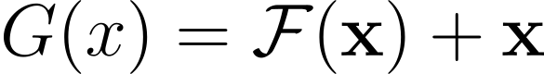
ResNet (2015)

Slide 36
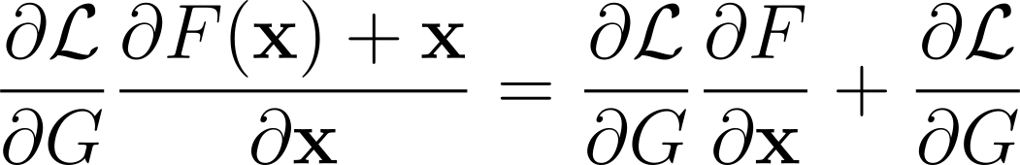
ResNet (2015)

Slide 37
ResNet (2015)

Slide 38
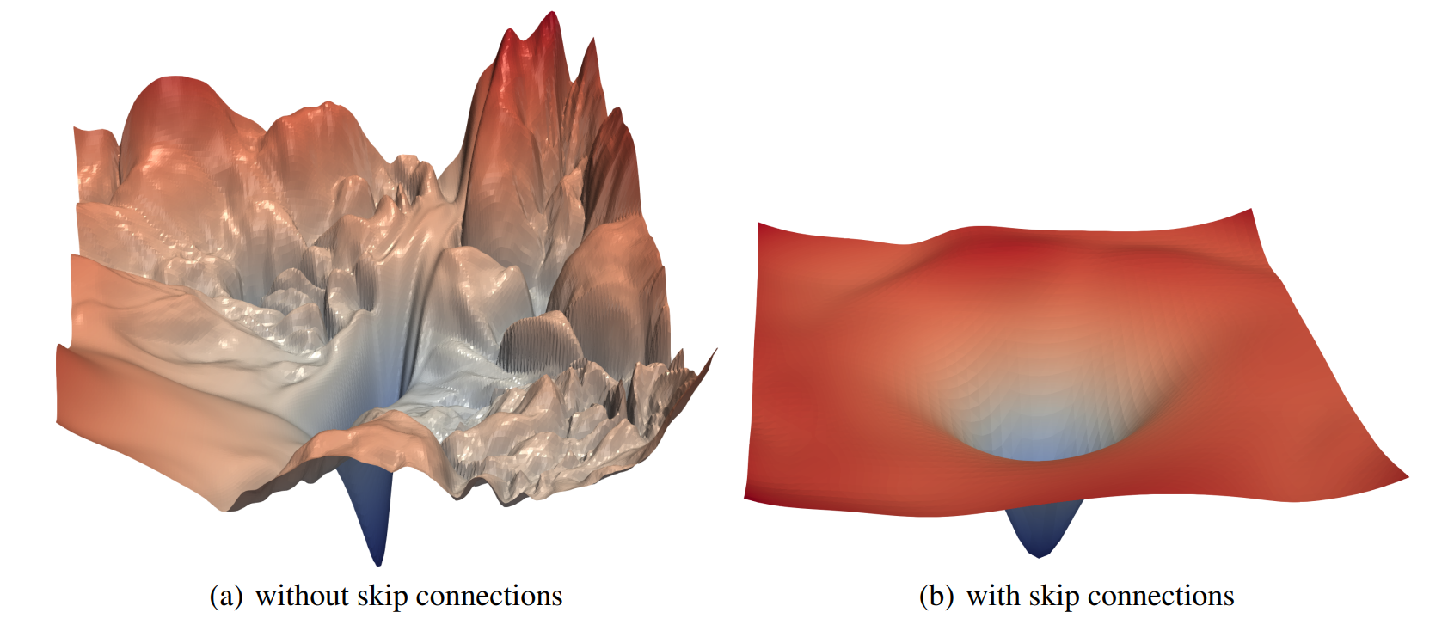
Li, H., Xu, Z., Taylor, G., & Goldstein, T. (2017). Visualizing the Loss Landscape of Neural Nets. NIPS
ResNet (2015)

Slide 39
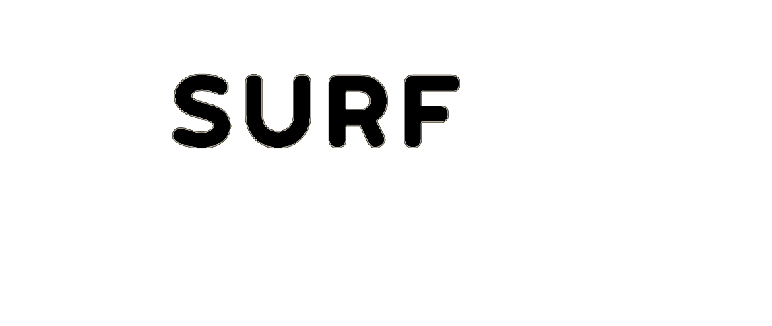
09/9/2024
Thank You
High Performance Machine Learning Group

Slide 40
Slides Graveyard
High Performance Machine Learning Group

Slide 41
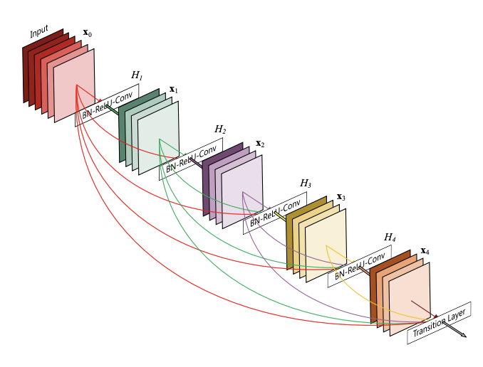
DenseNet (2016)
ResNets: construct large and deep models with skip connections, able to train up to 152 layers (!)
Higher abstraction and less nuisance from vanishing or exploding gradients
Early layers learn features that get progressively more abstract, we can preserve and control the flow of information with skip connections

Slide 42
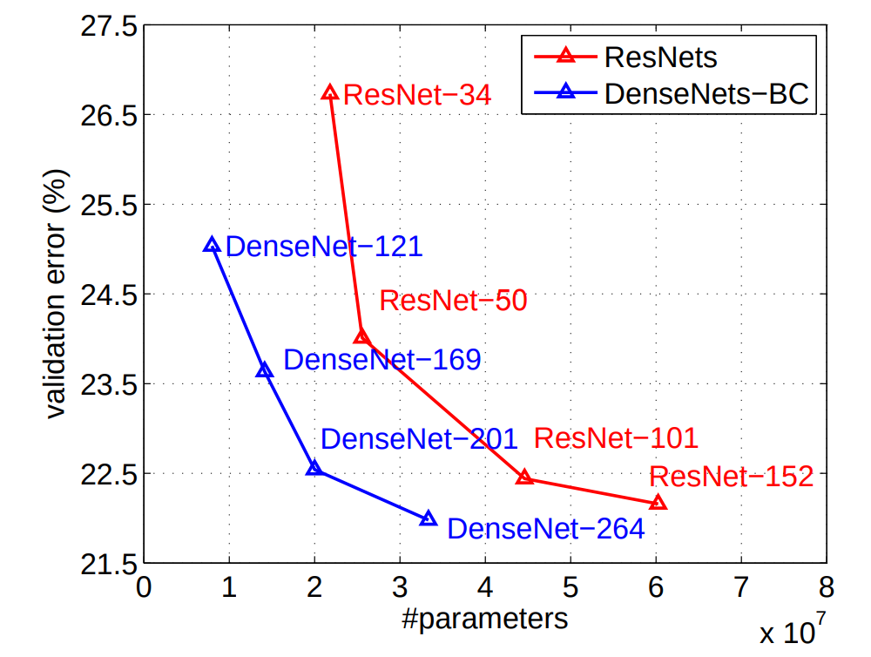
DenseNet (2016)
ResNets: construct large and deep models with skip connections, able to train up to 152 layers (!)
Higher abstraction and less nuisance from vanishing or exploding gradients
Early layers learn features that get progressively more abstract, we can preserve and control the flow of information with skip connections

Slide 43
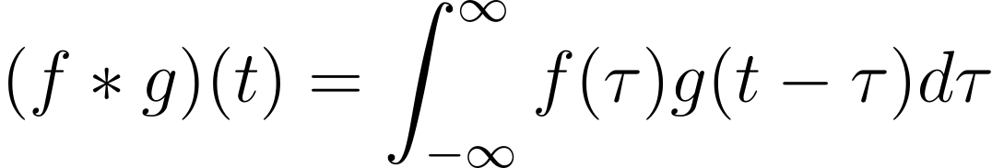
The Convolution Operation

Slide 44
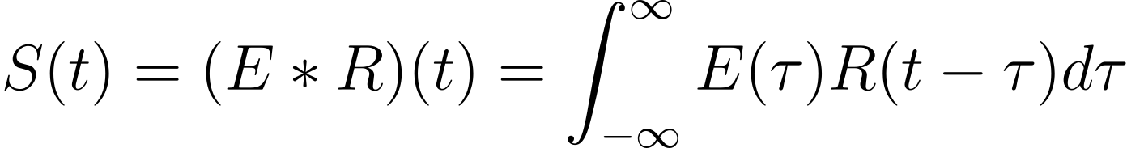
The Convolution Operation

Slide 45
The Convolution Operation
Impulse Response

Slide 46
The Convolution Operation
Source Signal
Impulse Response

Slide 47
The Convolution Operation
Seismogram
Source Signal
Impulse Response

Slide 48
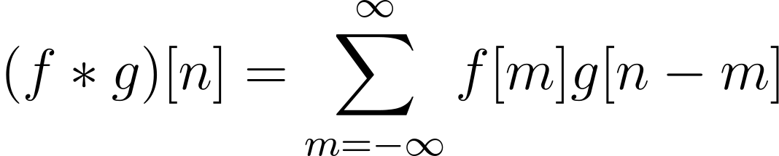
The Convolution Operation

Slide 49
The Convolution Operation
Initial signal gets modified by the system’s response
One signal slides across the other

Slide 50
Convolutions
Kernel (filter): small matrix that we use to convolve an image

Slide 51
Convolutions
Kernel (filter): small matrix that we use to convolve an image
Convolution:
An operation that “blends” one function with another.

Slide 52
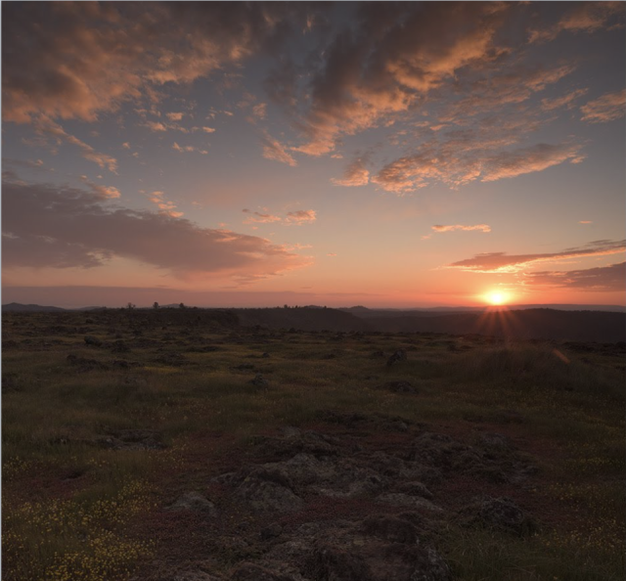

Convolutions
Kernel (filter): small matrix that we use to convolve an image
Convolution:
An operation that “blends” one function with another.
A filter applies a convolution operation on an image

Slide 53
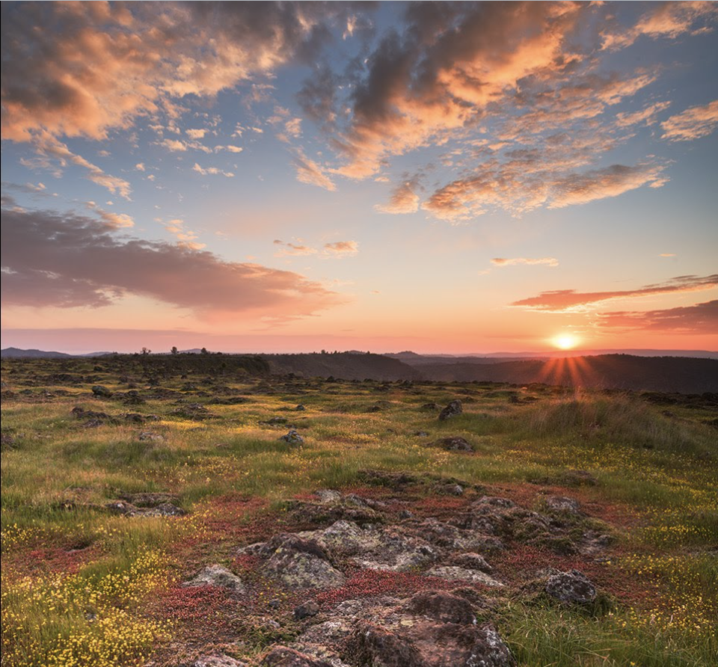
Convolutions
Kernel (filter): small matrix that we use to convolve an image
Convolution:
An operation that “blends” one function with another.
A filter applies a convolution operation on an image

Slide 54
How do Humans see?

Slide 55
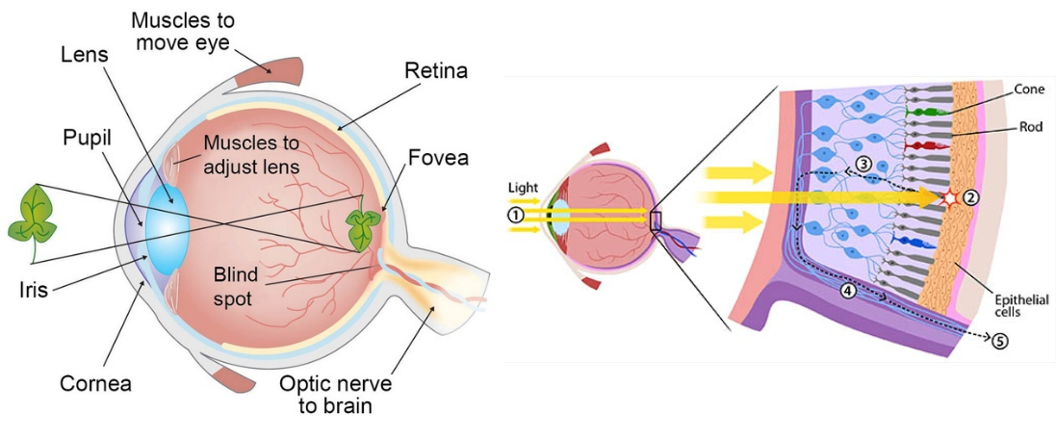
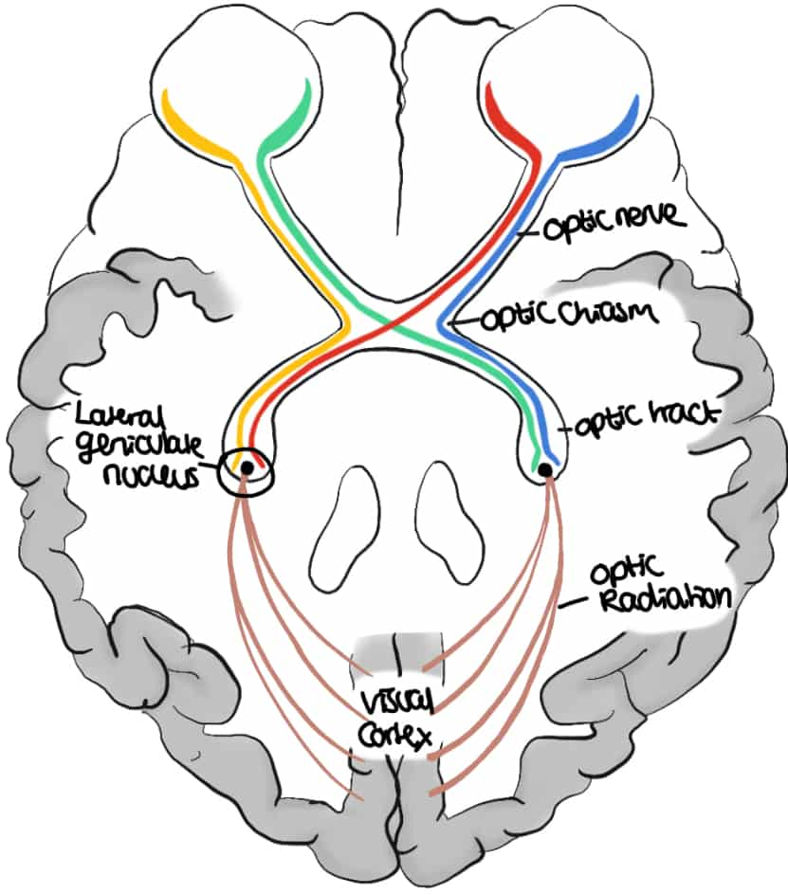
Mammalian Visual System

Slide 56
Mammalian Visual System
Cones and rods picks up photons and propagate the signal to the back of our brain
Along the way, the signal gets processed in stages

Slide 57
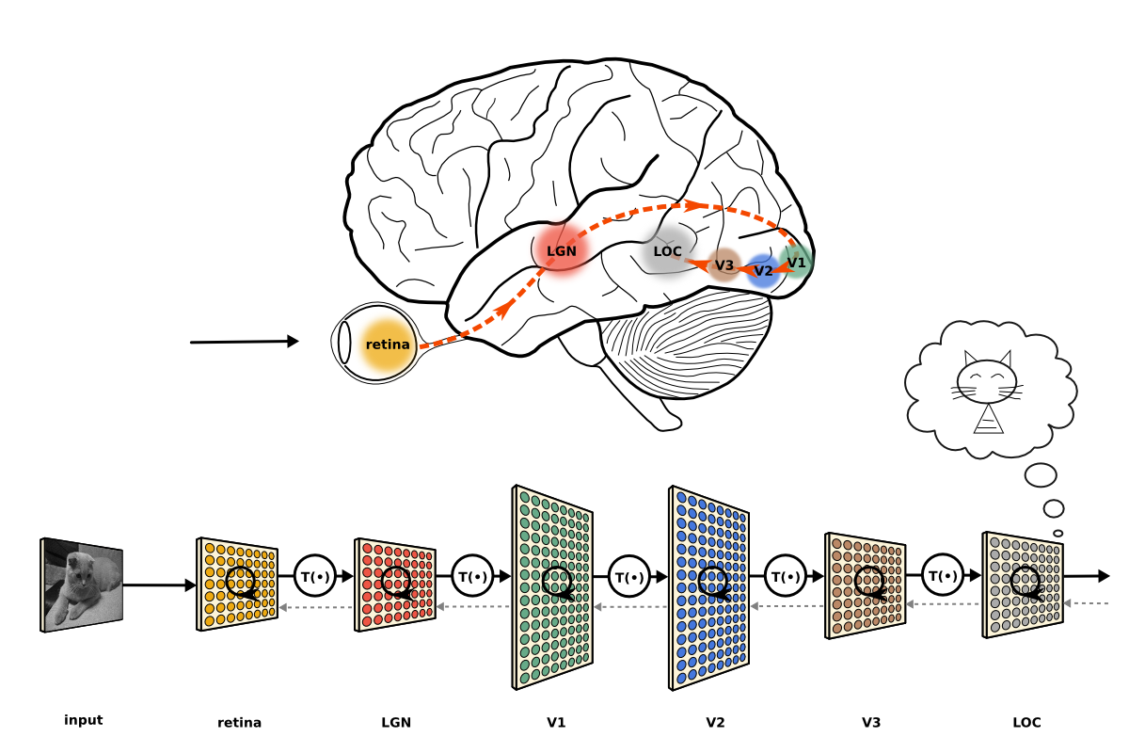
Mammalian Visual System
Cones and rods picks up photons and propagate the signal to the back of our brain
Along the way, the signal gets processed in stages
The extracted information gets aggregated and formed into an image

Slide 58
Mammalian Visual System
Cones and rods picks up photons and propagate the signal to the back of our brain
Along the way, the signal gets processed in stages
The extracted information gets aggregated and formed into an image

